Slide 1
Anomaly detection

Slide 2

Overview
Anomaly detection is the process of identifying unexpected items or events in data sets, which differ from the norm.
Simply, anomaly detection is the task of defining a boundary around normal data points so that they can be distinguishable from outliers.

Slide 3
Outlier OR Novelty?
Outlier
Novelty
unsupervised anomaly detection
The training data contains outliers which are defined as observations that are far from the others. Outlier detection estimators thus try to fit the regions where the training data is the most concentrated, ignoring the deviant observations.
semi-supervised anomaly detection
The training data is not polluted by outliers and we are interested in detecting whether a new observation is an outlier. In this context an outlier is also called a novelty.

Slide 4
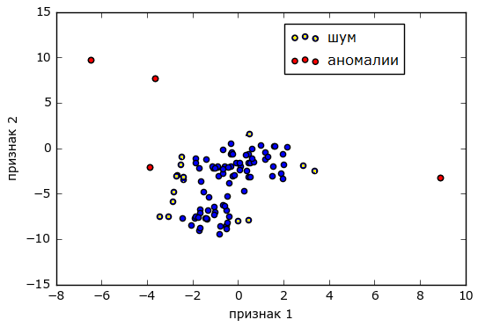
Outliers
data errors (measurement inaccuracies, rounding, incorrect record, etc.)
the presence of noise objects (incorrectly classified objects)
the presence of objects of “other” samples (for example, indications of a broken sensor).
Figure shows that noise is a “in the weak sense” outburst (it can blur the boundaries of the class / cluster a bit). We are primarily interested in emissions in the “strong sense” that distort these boundaries.

Slide 5
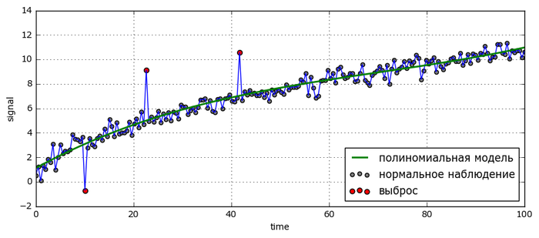
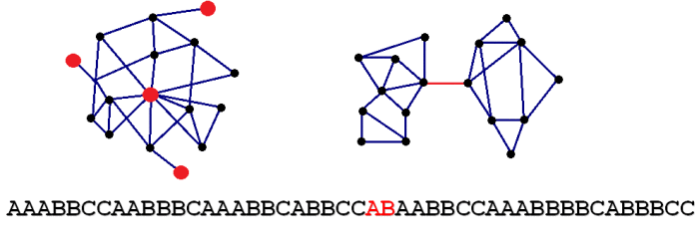
More visualization of outliers
There are either no examples of anomalies at all, or there are very few of them, and we don’t even know where exactly they are in the sample. That is why the task relates to learning without a teacher.

Slide 6
Applications
Detection of suspicious banking transactions (Credit-card Fraud) (Обнаружение подозрительных банковских операций )
Intrusion Detection (Обнаружение вторжений)
Detection of non-standard players on the exchange (insiders) (Обнаружение нестандартных игроков на бирже)
Detection of malfunctions in mechanisms according to sensor readings
Medical Diagnosis
Seismology

Slide 7
Anomalies can be broadly categorized as:
Point anomalies: A single instance of data is anomalous if it's too far off from the rest. Business use case: Detecting credit card fraud based on "amount spent."
Contextual anomalies: The abnormality is context specific. This type of anomaly is common in time-series data. Business use case: Spending $100 on food every day during the holiday season is normal, but may be odd otherwise.
Collective anomalies: A set of data instances collectively helps in detecting anomalies. Business use case: Someone is trying to copy data form a remote machine to a local host unexpectedly, an anomaly that would be flagged as a potential cyber attack.

Slide 8
Machine Learning-Based Approaches
Density-Based Anomaly Detection
Normal data points occur around a dense neighborhood and abnormalities are far away.
Clustering-Based Anomaly Detection
Data points that are similar tend to belong to similar groups or clusters, as determined by their distance from local centroids.
Support Vector Machine-Based Anomaly Detection
The algorithm learns a soft boundary in order to cluster the normal data instances using the training set, and then, using the testing instance, it tunes itself to identify the abnormalities that fall outside the learned region.

Slide 9
Density-Based Anomaly Detection (Probabilistic approach)
We believe that the anomaly is an object that was obtained from another distribution, not from the distribution that generated the main training sample for us.
Suppose we managed to figure out the RIGHT DISTRIBUTION.
If the probability of getting a new object from this distribution is very small, then this is most likely an anomaly.
How to find the right distribution?

Slide 10
probability densities types
Parametric approach
Nonparametric approach
Recovery of mixtures.

Slide 11

Parametric approach
We believe that there is some probability distribution p (x):
It is considered that this distribution is parametric, that is, in fact, this is a certain distribution φ of x, which depends on some parameter θ.

Slide 12


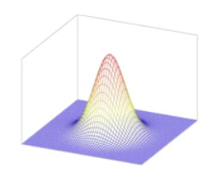
normal distribution
The normal distribution consists of two parameters - μ and Σ, the center and the covariance matrix.
Σ determines the scatter of this hat
How to find these parameters????
μ determines the center of this hat

Slide 13



Parameters
the probability of the objects of the training sample from the point of view of this distribution is maximum.
objects that are not similar to this sample are likely to receive low probabilities.
Actually, this is exactly how the maximum likelihood method works, which tries to select such a distribution from a parametric family that, from his point of view, the objects of the training sample will be as likely as possible.
sample covariance matrix
the average of all objects in the sample

Slide 14
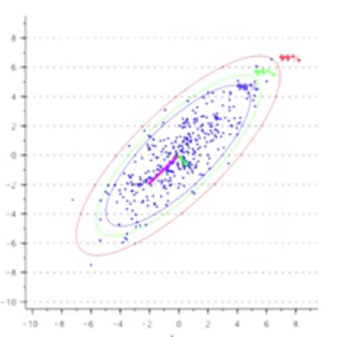
Density distribution
95% of all probability
(green line)
90% of all probability
(blue line)
99% of all probability
(red line)
Very low probability

Slide 15
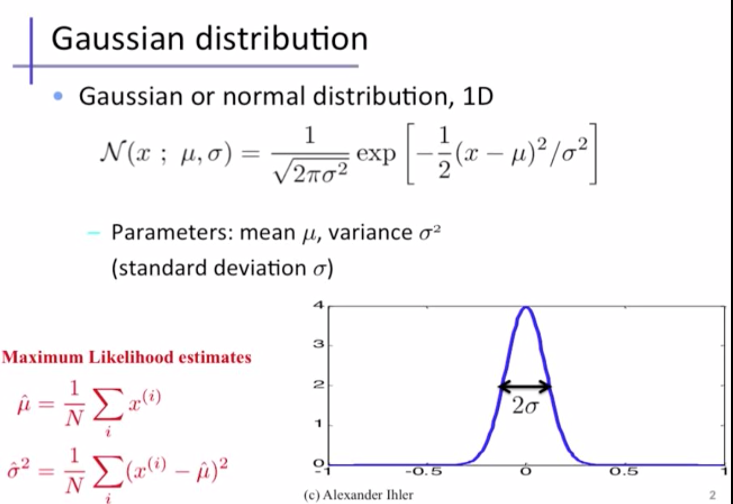
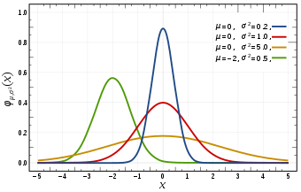
p(x, μ,Σ) - probability
if p < e
anomaly
if p >= e
OK

Slide 16
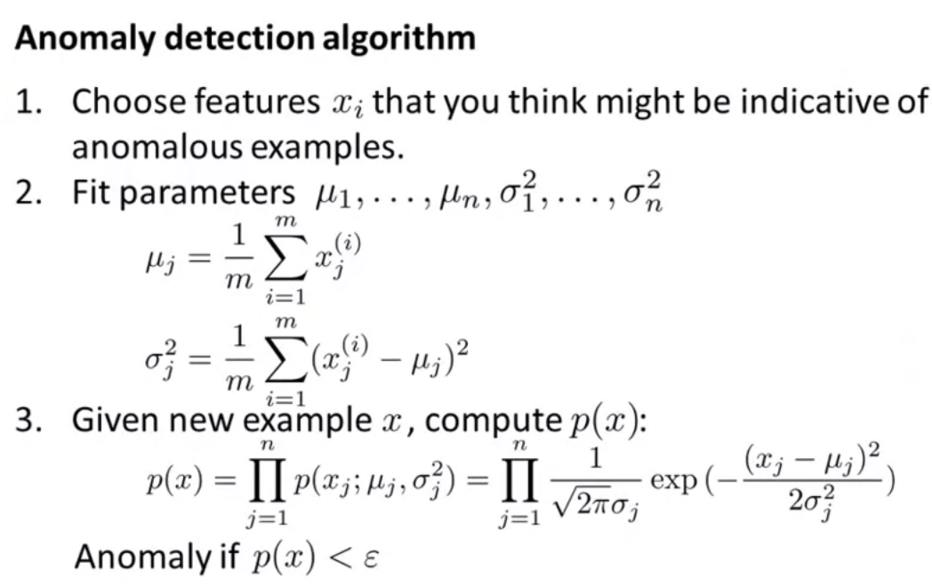
For each feature it’s own mu and sigma

Slide 17
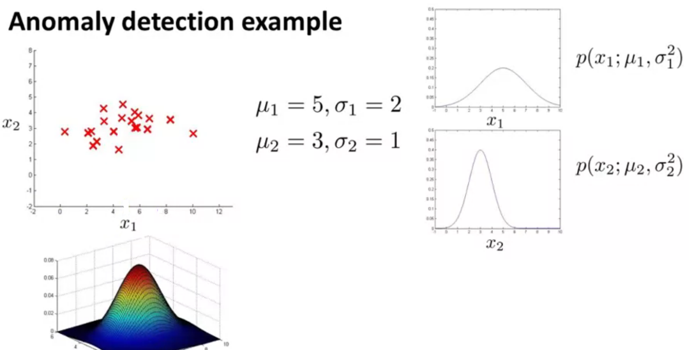
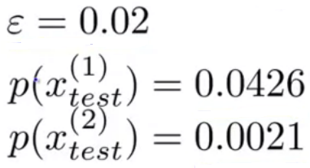
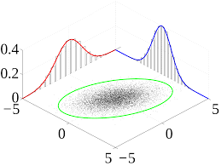
Another example

Slide 18
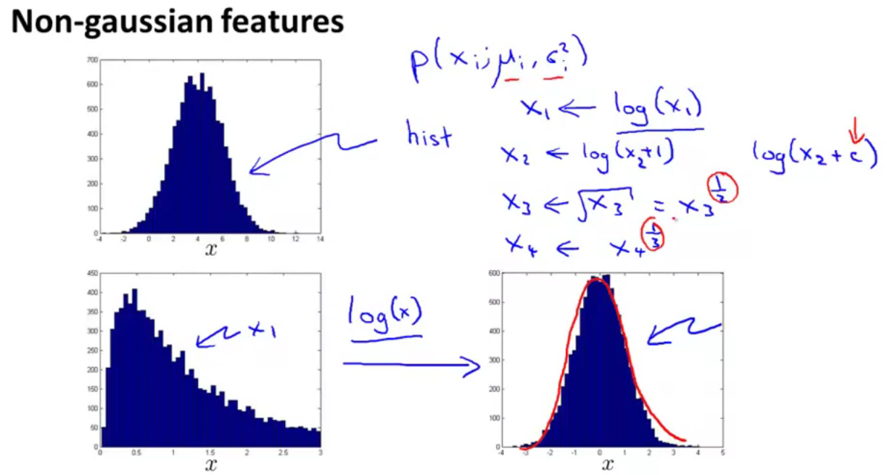

Slide 19
